Slide 1


Ethical Considerations in Digital Investigations
Computer forensics is the practice of investigating digital devices and data to uncover evidence for legal or security purposes. It involves collecting, preserving, and analyzing digital information to solve crimes, resolve disputes, or enhance organizational security.

Slide 2
Ethical Considerations in Digital Investigations
Privacy and Consent
Confidentiality of Data
Transparency and Objectivity
Minimizing Harm
The investigation process should be designed to minimize any potential harm to individuals, organizations, or broader societal interests. Ethical considerations must guide every step.
Digital investigations must respect the privacy rights of individuals. Obtaining informed consent from data owners is crucial to ensure ethical data collection and analysis.
Sensitive personal or organizational data uncovered during an investigation must be handled with the utmost confidentiality. Unauthorized disclosure can lead to significant harm.
Investigators must maintain transparency about their methods and remain objective in their findings. Biases or conflicts of interest can compromise the integrity of the investigation.

Slide 3
Preserving Digital Evidence
Secure Data Collection
1
Carefully acquire digital evidence to ensure integrity.
Robust Chain of Custody
2
Document every step of the evidence handling process.
Tamper-Evident Packaging
3
Protect data from modification or destruction.
Preserving the integrity of digital evidence is crucial in computer forensics. This involves securely collecting and storing data, maintaining a robust chain of custody, and using tamper-evident packaging to ensure the evidence remains uncompromised throughout the investigation. These steps are essential for upholding the admissibility and reliability of the digital evidence in legal proceedings.

Slide 4



Protecting Privacy and Confidentiality
Data Privacy
Confidentiality
Ethical Practices
Ensure strict protocols for handling sensitive personal information. Prioritize data minimization and secure storage to protect individuals' rights.
Maintain the confidentiality of privileged or proprietary data. Restrict access and only disclose information when legally required or with explicit consent.
Adhere to professional ethical guidelines and organizational policies. Uphold principles of integrity, objectivity, and respect for persons.

Slide 5
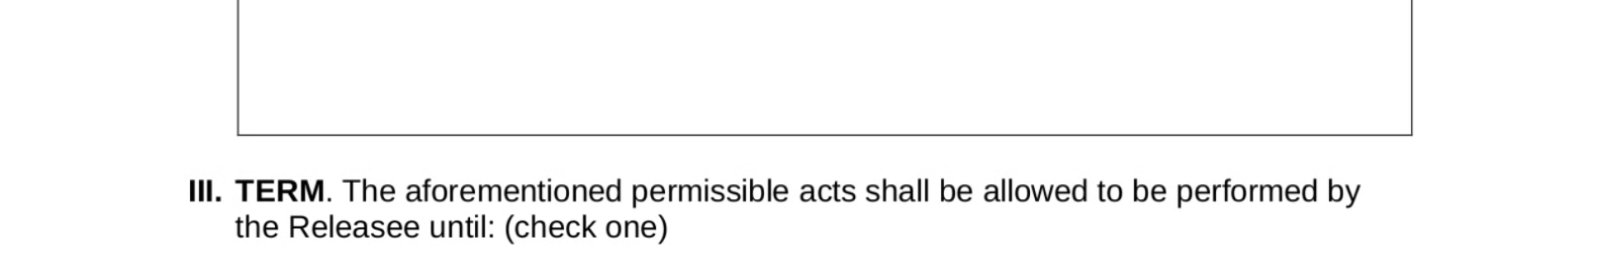
Informed Consent and Consent to Search
Obtain Explicit Consent
Explain Scope and Purpose
Document Consent Process
Ensure individuals provide clear, explicit consent before conducting any digital searches or data collection. This protects their rights and privacy.
Clearly communicate the purpose, scope, and limitations of the investigation to obtain informed consent. Be transparent about how data will be used.
Maintain detailed records of the consent process, including any restrictions or conditions placed by the individual. This provides an audit trail.

Slide 6

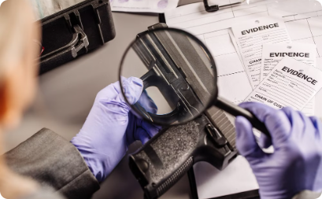
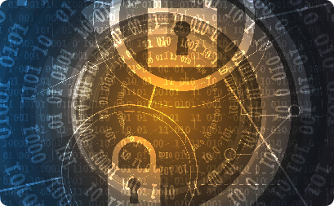
Handling Sensitive or Privileged Information
Protecting Confidentiality
Legal Compliance
Data Encryption and Security
Computer forensic professionals must handle sensitive or privileged information with the utmost care, ensuring confidentiality and preventing unauthorized access or disclosure.
When dealing with privileged information, such as attorney-client communications or protected health data, forensic investigators must strictly adhere to legal requirements and obtain proper authorizations.
Robust data encryption and security measures are essential to safeguard sensitive information during the collection, analysis, and storage of digital evidence.

Slide 7
Reporting Findings and Maintaining Objectivity
1
Clarity and Transparency
2
Maintaining Objectivity
Present findings in a clear, concise, and unambiguous manner. Avoid jargon and technical language when communicating with non-technical stakeholders.
Ensure that conclusions and recommendations are based solely on the evidence gathered, without any personal biases or preconceptions.
3
Acknowledging Limitations
4
Ethical Documentation
Openly disclose any limitations in the investigation or analysis, and the potential impact on the findings.
Document the forensic process, chain of custody, and any deviations from standard procedures to demonstrate the integrity of the investigation.

Slide 8
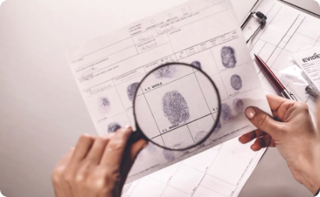
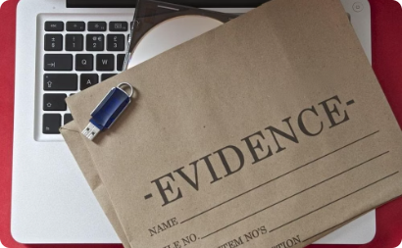
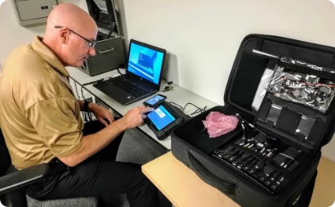
Ethical Challenges in Cross-Border Investigations
Navigating Legal Frameworks
Respecting Cultural Differences
Coordinating with Foreign Authorities
Computer forensic investigations that cross international borders must comply with complex and often conflicting legal frameworks, raising ethical challenges around data privacy and jurisdiction.
Investigators must be sensitive to cultural norms and practices when conducting digital forensics in other countries, ensuring their methods do not violate local customs or values.
Ethical collaboration with law enforcement and judicial authorities in other nations is crucial, but can be complicated by differences in investigation protocols and rules of evidence.

Slide 9



Ethical Guidelines and Professional Standards
Legal Compliance
Professional Codes
Fairness and Objectivity
Computer forensics professionals must adhere to all applicable laws and regulations governing the collection and handling of digital evidence.
Industry associations like IACIS and ISFCE maintain ethical codes of conduct that provide guidance on best practices and standards of care.
Forensic examiners must remain impartial and objective, avoiding bias or conflict of interest when analyzing digital evidence.

Slide 10
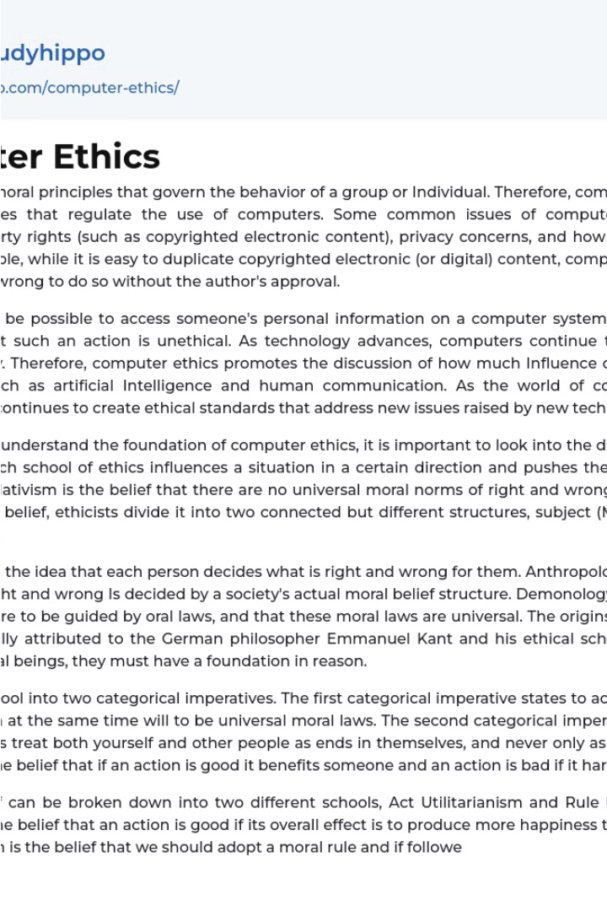
Conclusion and Recommendations
In conclusion, the ethical challenges in computer forensics require a thoughtful and principled approach. Maintaining privacy, securing evidence, and upholding professional standards are critical to ensuring justice is served while respecting fundamental rights.

